Slide 1
Project 1
Scala-Hive Interface
Alex Smith
Daniel Hoelzel
Notes:
Hello, I am [name] and this is our project for project 1. For project 1, we created a scala program that interfaces with hive to return queries from the database. This program is able to return answers to certain queries about films to help the user find certain films to watch or inform them about films that may match their specifications based on certain genres, ratings, and year the films were made.

Slide 2
Data used:
ml-latest-small
We performed data normalization using regular expressions to transform the data into a more usable format.
We extracted the release year from the movie titles and stored the release year data in its own column. A NULL value was placed in that column for movie titles that did not include a release year.
Notes:
We used the ml-latest-small dataset, which is a scaled-down version of the larger movielens dataset. We used 2 tables from the dataset, the movies table and the ratings table. In the movies table, we normalized the data using regular expressions to remove the movie’s release year out of the movie title string and into its own column. This makes the titles more readable and the year data easier to work with. The handful of titles that did not have a year were given a NULL value for that field.

Slide 3
Query 1: Show the top 25 rated movies with at least 50 votes
SELECT results.* FROM (SELECT movies.movieid, movies.title, COUNT(ratings.rating) AS votes, AVG(ratings.rating) AS avgratings
FROM movies JOIN ratings ON movies.movieid = ratings.movieid
GROUP BY movies.movieid, movies.title) results
WHERE results.votes > 49
ORDER BY avgratings DESC LIMIT 25;
Notes:
For the first query, we decided to show the top 25 movies each with at least 50 votes from users. We selected the movies table to get the id and title of the movies. We then joined with the ratings table which also had an id field for the movies, and used it to find the ratings. We then counted all of the votes and took an average of the ratings. Then we print out the result in order of rating for films that had at least 50 votes.

Slide 4
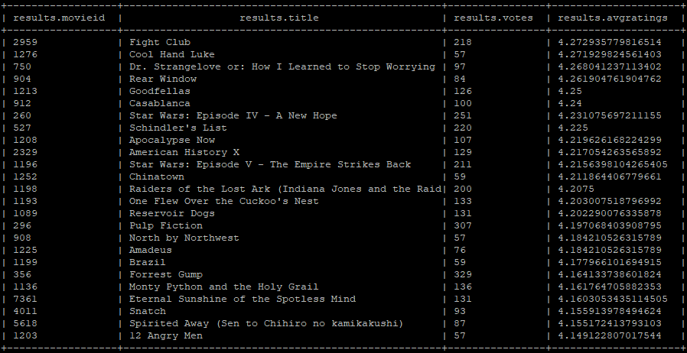
Query 1 results:
Notes:
In this table, you can see the average ratings as well as the number of votes each film received. In this dataset, none of the films had the exact same average rating, but if they did, they would be sorted in order of the most votes for that rating first.

Slide 5
Query 1 explanation:
Throughout the dataset there are numerous instances of movies with a very high or low average rating, but a very low number of votes. With a low enough vote count, a movie’s listed rating could be misleading and vary wildly from the public’s overall perception of the film.
By limiting our query to only movies with at least 50 ratings we can be much more confident that the ratings we’re seeing are representative of public opinion.
Notes:
Throughout our dataset, there are many times when there are films that have very high or low ratings because they have a very low number of votes. This can be misleading as it does not accurately represent how the movie was perceived by a larger audience. As a result, we wanted to make sure we only looked at movies with a decent set of votes to get a more accurate average rating of these films.

Slide 6
Query 2: What are the top rated movies listed as both action and comedy
SELECT movies.movieid, movies.title, count (ratings.rating) AS votes, AVG(ratings.rating) AS avgratings FROM movies
JOIN ratings ON movies.movieid = ratings.movieid
WHERE movies.genre LIKE '%Action%' AND movies.genre LIKE '%Comedy%'
GROUP BY movies.movieid, movies.title ORDER BY avgratings DESC, votes DESC LIMIT 25;
Notes:
In the second query, we wanted to look into how to search a specific genre or multiple genres of a movie. The genres are listed in a string separated by a vertical bar, so we used the wildcard % to be able to find the given genre in that string. We then took all the movies with the given genres and compared it to the ratings table to find their average ratings.

Slide 7
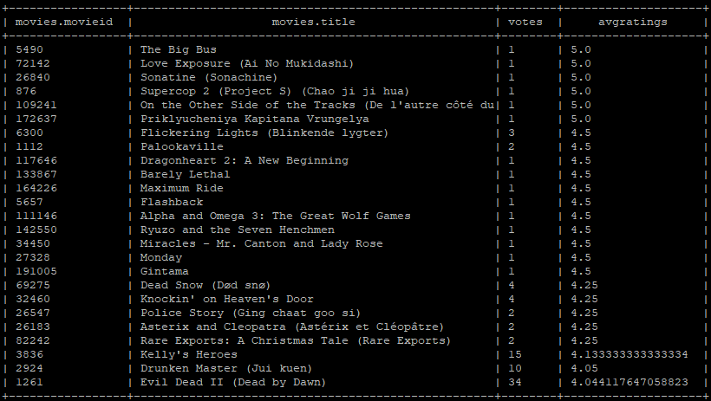
Query 2 results:
Notes:
This table didn’t separate the results bases on number of votes so there are quite a few films with less than 5 votes, but all the listed films here have both of the genres we searched for and are listed in the order of their average rating.

Slide 8
Query 2 explanation:
With the ratings and movie titles in 2 different tables, we had to join the 2 tables to be able to get an accurate way to translate the best movies to their titles.
In addition to this, in our dataset, the movie genres were listed in a string such as Adventure|Animation|Children|Comedy|Fantasy so we had to find a way to search through the tags and match the 2 we were looking for. We were able to do this using the wildcard characters such as: '%Action%'.
Notes:
With the genres and the ratings listed in 2 different tables, we had to join the tables to be able to have access to both. This dataset also had the genres listed in a string separated by vertical bars, so we had to use SQL wildcards statements to be able to search the string for the given genre.

Slide 9
Query 3: Show the top 25 movies with the highest number of ratings
SELECT movies.movieid, movies.title, COUNT(ratings.rating) AS votes
FROM movies JOIN ratings ON movies.movieid = ratings.movieid
GROUP BY movies.movieid, movies.title ORDER BY votes DESC LIMIT 25;
Notes:
For our third query, we decided to look for films that had the highest number of ratings by users. This one was a little easier as we didn’t care about the rating itself but just the number of them which we could get using the count function. We again used the movieid to match the tables so we could print out the title of the movie.

Slide 10
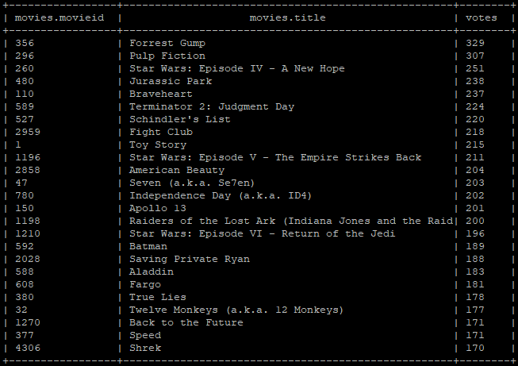
Query 3 results:
Notes:
As you can see, many of these films are fairly popular so they have many votes such as Forrest Gump, Star Wars, and even Shrek. Again this is just the number of votes and is not based on the average rating of any of these films.

Slide 11
Query 3 explanation
Same as with query 2 we had to join the 2 tables to get the number of votes and the titles together.
We then just had to order by number of votes to get them in the correct order.
Notes:
Similar to how we had to do in query 2, we had to join the 2 tables together again to get the titles and number of votes at the same time. Then we just ordered them by number of votes to get the result.

Slide 12
Query 4: What are the top 10 movies in a given year?
SELECT movies.movieid, movies.title, movies.year, AVG(ratings.rating) AS avg_ratings FROM movies
JOIN ratings ON movies.movieid = ratings.movieid
WHERE movies.year = 1996
GROUP BY movies.movieid
ORDER BY avg_ratings DESC LIMIT 10;
Notes:
The final query we decided to use was how to get the top 10 rated movies in a given year. Our data set had movies from as early as 1902 and as late as 2018, so we decided to use 1996 as the year for our query. In this query, we already separated the movie year from the titles using regular expressions, so it was easy to be able to separate the movies in a given year from the rest. Then we just had to get the average rating from the ratings table and sort them to find the top 10.

Slide 13
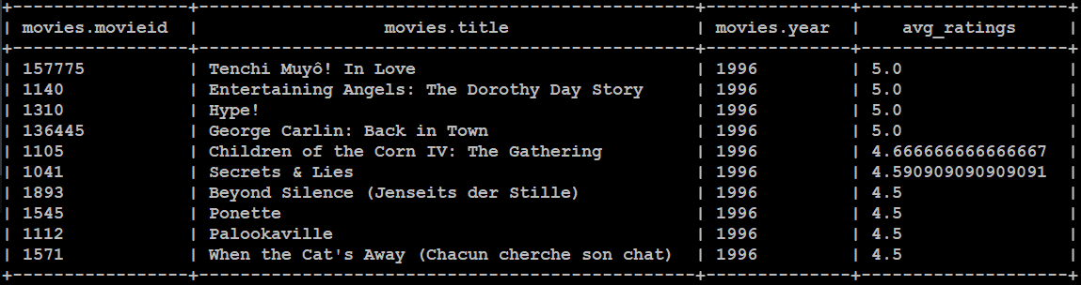
Query 4 results:
Notes:
Many of the films near the top have a similar rating so some of these may have a small number of votes, but based on their average ratings, this is the order they appeared in with this query.

Slide 14
Query 4 explanation:
After separating the year on the movies into its own column, it was easy enough to narrow down each search into a given year.
We could then take the average rating of each movie in a given year to give a list of the top 10 movies of that year.
Notes:
After separating the year from the movie title, this was a very easy query to do. With the years separate, all we had to do was find the average rating using the where statement to get the result.

Slide 15
Additional Ideas/Improvements
Additional query options that are a little more in depth or have more interesting queries.
Improve from simple CLI to actual program with a GUI to make it more accessible.
Notes:
Finally, if we had a little more time for this project, there would be a few more things we could add to make the project better. First, we could have done more in depth or more interesting queries if we wanted to. Another thing we could do given more time would be to make the program a little more easy to use or accessible if we were able to change it from a CLI interface to an actual GUI for this project.

